Slide 1
Unit Six

Slide 2
1. Anonymous: unnamed, without the name of the person involved (writer/composer, etc.); unknown, nameless; lacking individuality or character
Unit 6
Adjective
The detective received an anonymous tip that helped to narrow the search for the thief.

Slide 3
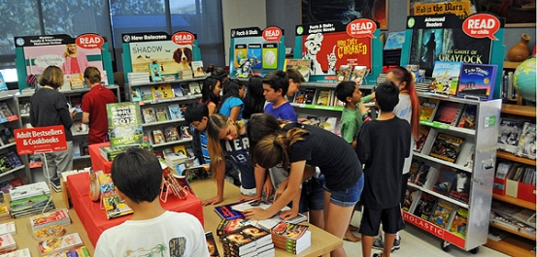
2. Browse: to nibble, graze; to read casually, skim, scan; to window-shop
Unit 6
Verb
I like to browse through a book before I buy it.

Slide 4
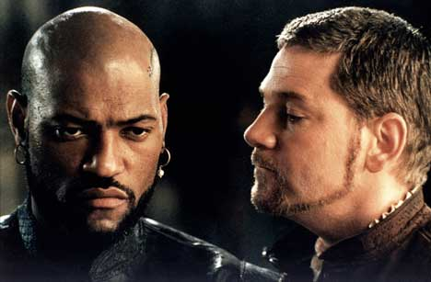
3. Dupe: n. a person easily tricked or deceived; v. to deceive
Unit 6
Noun
or
Verb
Othello plays the dupe in Shakespeare’s play Othello. (n.)
Iago dupes Othello by telling him lies and playing tricks upon him. (v.)

Slide 5
4. Dynamic: active, energetic, forceful, high-powered
Unit 6
Adjective
The advertising agency was looking to hire a creative person with a dynamic personality.

Slide 6
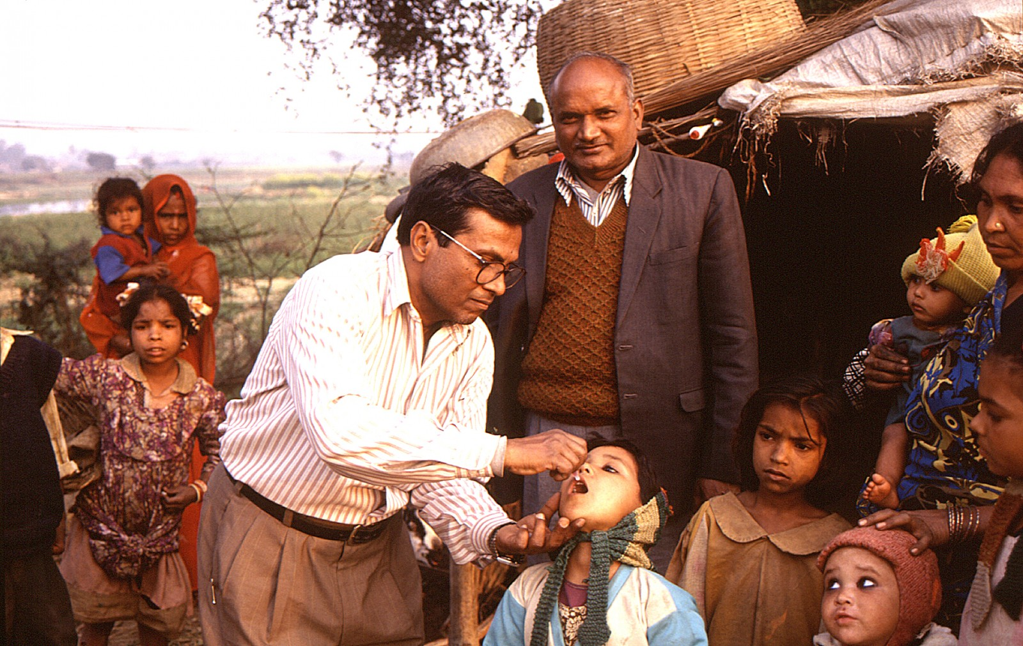
5. Eradicate: to root out, get rid of, destroy completely
Unit 6
Verb
The team of doctors and researchers are working tirelessly to eradicate Polio.

Slide 7
6. Frustrate: to prevent from accomplishing a purpose or fulfilling a desire; to cause feelings of discouragement, thwart, foil, baffle, disappoint
Unit 6
Verb
Nothing could frustrate our plans to storm the fort.
When my printer doesn’t work I feel so frustrated I might yell!
http://www.youtube.com/watch?feature=player_detailpage&v=oGYvDbkfA5o

Slide 8
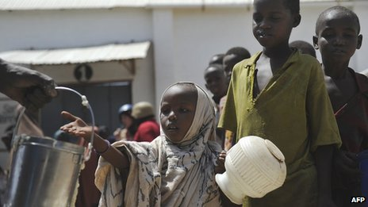
7. Grim: stern, merciless; fierce, savage, cruel, dreadful, frightful
Unit 6
Adjective
Many Third World nations face the grim prospect of famine.
Between 2010-2012 the Somalia famine killed 260,000 people (BBC News. 2 May 2013.)

Slide 9
8. Inimitable: not capable of being copied or imitated, unique
Unit 6
Adjective
The young performer stole the show with her inimitable charm.

Slide 10
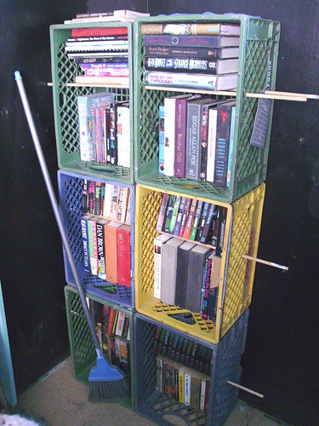
9. Makeshift: n. a temporary substitute for something else, substitute; adj. crude, flimsy, or temporary
Unit 6
Noun
or
Adjective
The crates are only a makeshift until the bookcase arrives. (n.)
The crates serve as a makeshift bookcase until our new one arrives. (adj.)

Slide 11
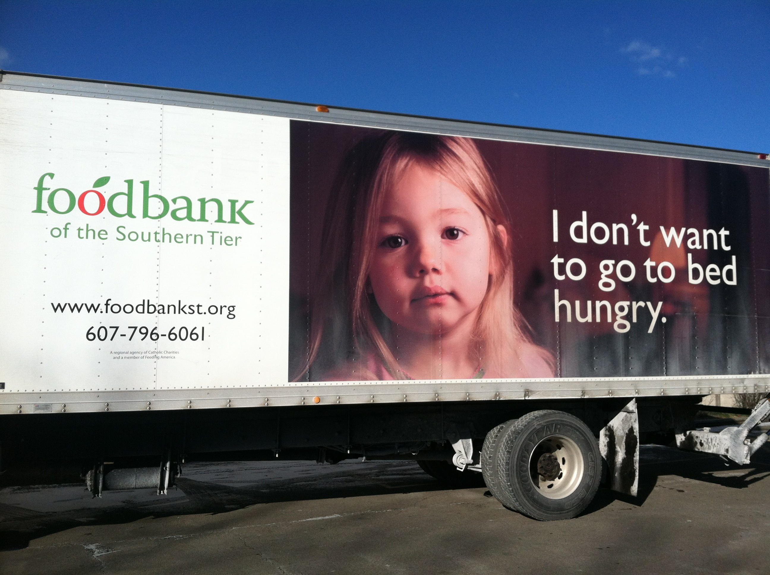
10. Marginal: in, at, or near the edge or margin; only barely good, large or important enough for the purpose, borderline, minimal
Unit 6
Adjective
During times of economic hardship, many people have only a marginal standard of living.

Slide 12
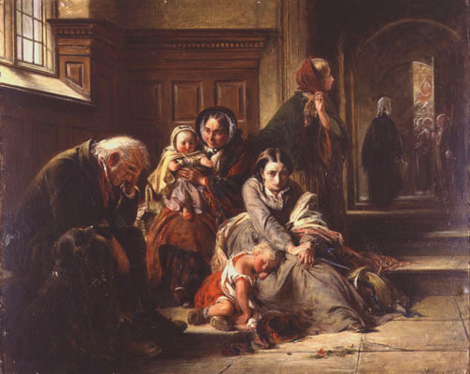
11. Pending: waiting to be settled, undecided; until
Unit 6
Adjective
or
Preposition
Curiosity about the pending trial builds with each day. (adj.)
Sentencing of the convicted criminal was postponed pending the judge’s decision. (prep).
“Waiting for the Verdict” by Abraham Solomon, 1857

Slide 13
12. Prescribe: to order as a rule or course to be followed; to order for medical purposes, specify
Unit 6
Verb
The doctor was quick to prescribe the medicine for the patient’s illness.

Slide 14
13. Preview: n. something seen in advance, foretaste; v. to view beforehand
Unit 6
Noun
or
Verb
The critics saw a preview of the new movie. (n.)
The teacher wished to preview the video before showing it to the class. (v.)

Slide 15
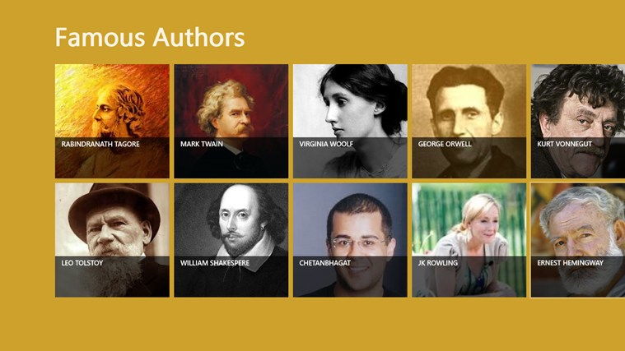
14. Prominent: standing out so as to be easily seen, noticeable; important, well-known
Unit 6
Adjective
Some famous authors are prominent figures in society.

Slide 16
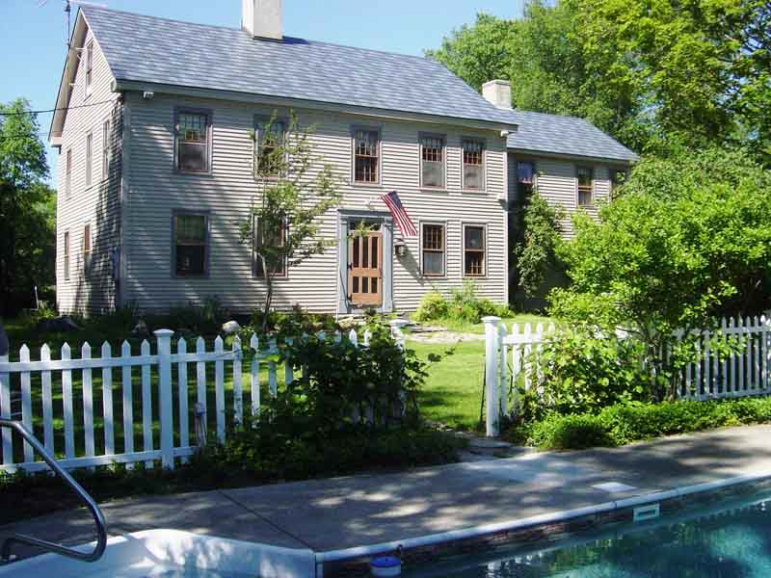
15. Quaint: odd or old-fashioned in a pleasing way; clever, ingenious; skillfully made, picturesque, peculiar, curious
Unit 6
Adjective
My parents stayed at a quaint old inn in Vermont.

Slide 17
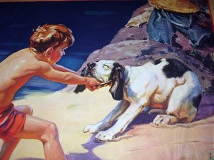
16. Reluctant: unwilling, holding back, hesitant, disinclined
Unit 6
Adjective
The reluctant dog would not go swimming with the boy.

Slide 18
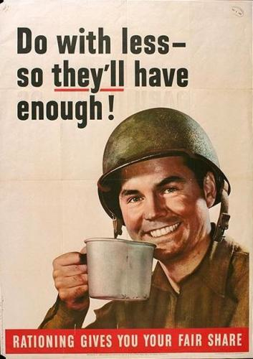
17. Scrimp: to handle very economically or stingily; to supply in a way that is small, short, or scanty, economize
Unit 6
Verb
During World War II families were forced to scrimp on supplies because of the rationing system.

Slide 19
18. Snare: v. to trap, catch, entrap; n. a trap or entanglement, pitfall
Unit 6
Verb
or
Noun
They set a trap to snare the rodents that were getting into the garden. (v.)
The unsuspecting spy was caught in a snare set by the other side. (n.)

Slide 20
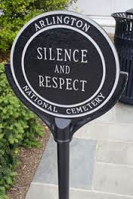
19. Utmost: adj. greatest, highest, farthest, best; n. the extreme limit, best
Unit 6
Adjective
or
Noun
The students had the upmost regard for our military heroes buried in the National Cemetery. (adj.)

Slide 21
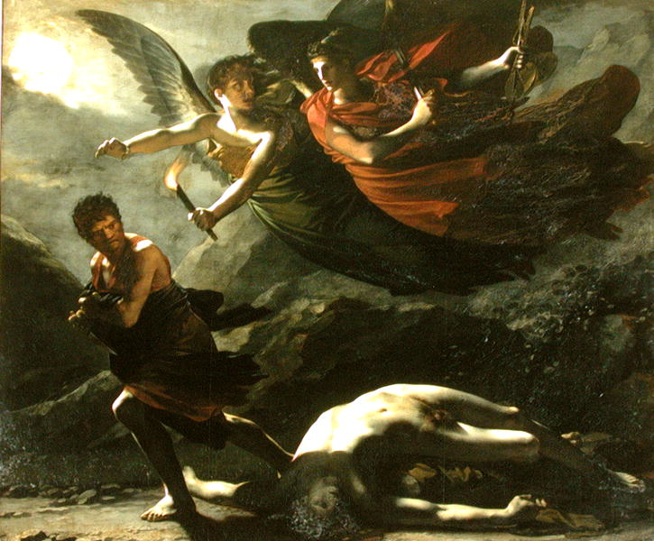
20. Vengeance: punishment in return for an injury or a wrong; unusual force or violence, revenge, retaliation, reprisal
Unit 6
Noun
History is filled with examples of wronged rulers seeking vengeance against their enemies.
“Justice and Divine Vengeance Pursuing Crime” by Pierre-Paul Prud'hon, 1808

